Slide 1

Fundamentals of Programming Using Flowchart and Pseudocode

Slide 2
What is Programming? How do I get Started?
Understand the big picture of Software Development
Any project involves various stages
Software Development Life Cycle (SDLC) stages:
Requirements Gathering
Design
Software Development
Quality Assurance
Deployment

Slide 3
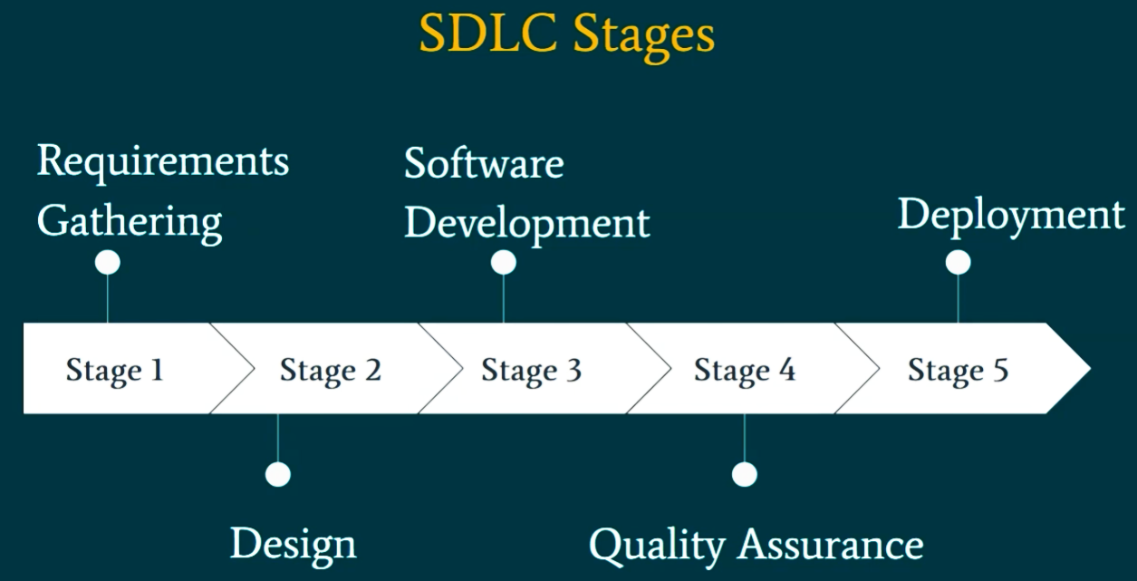
SDLC Stages

Slide 4
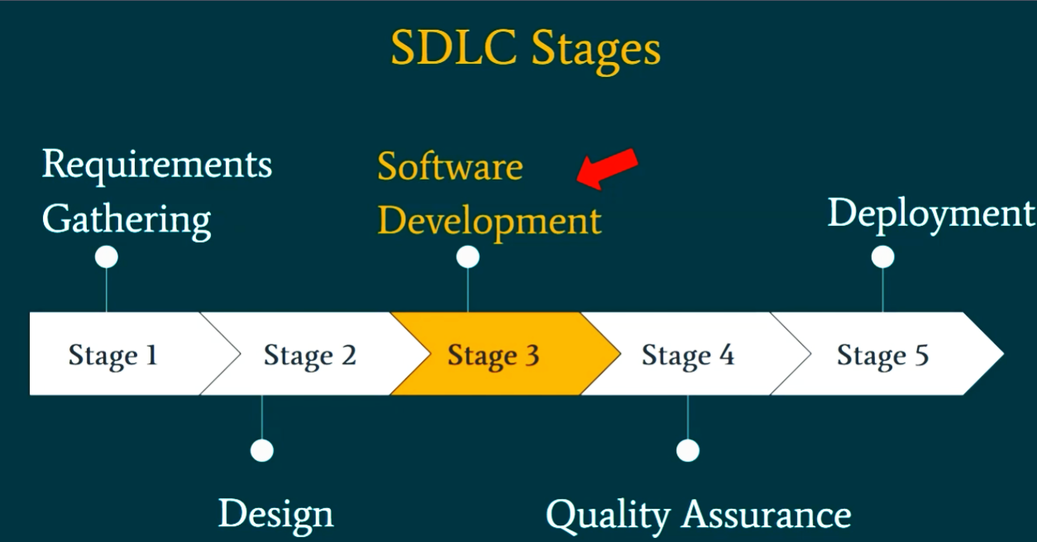
SDLC Stages –Software Development

Slide 5
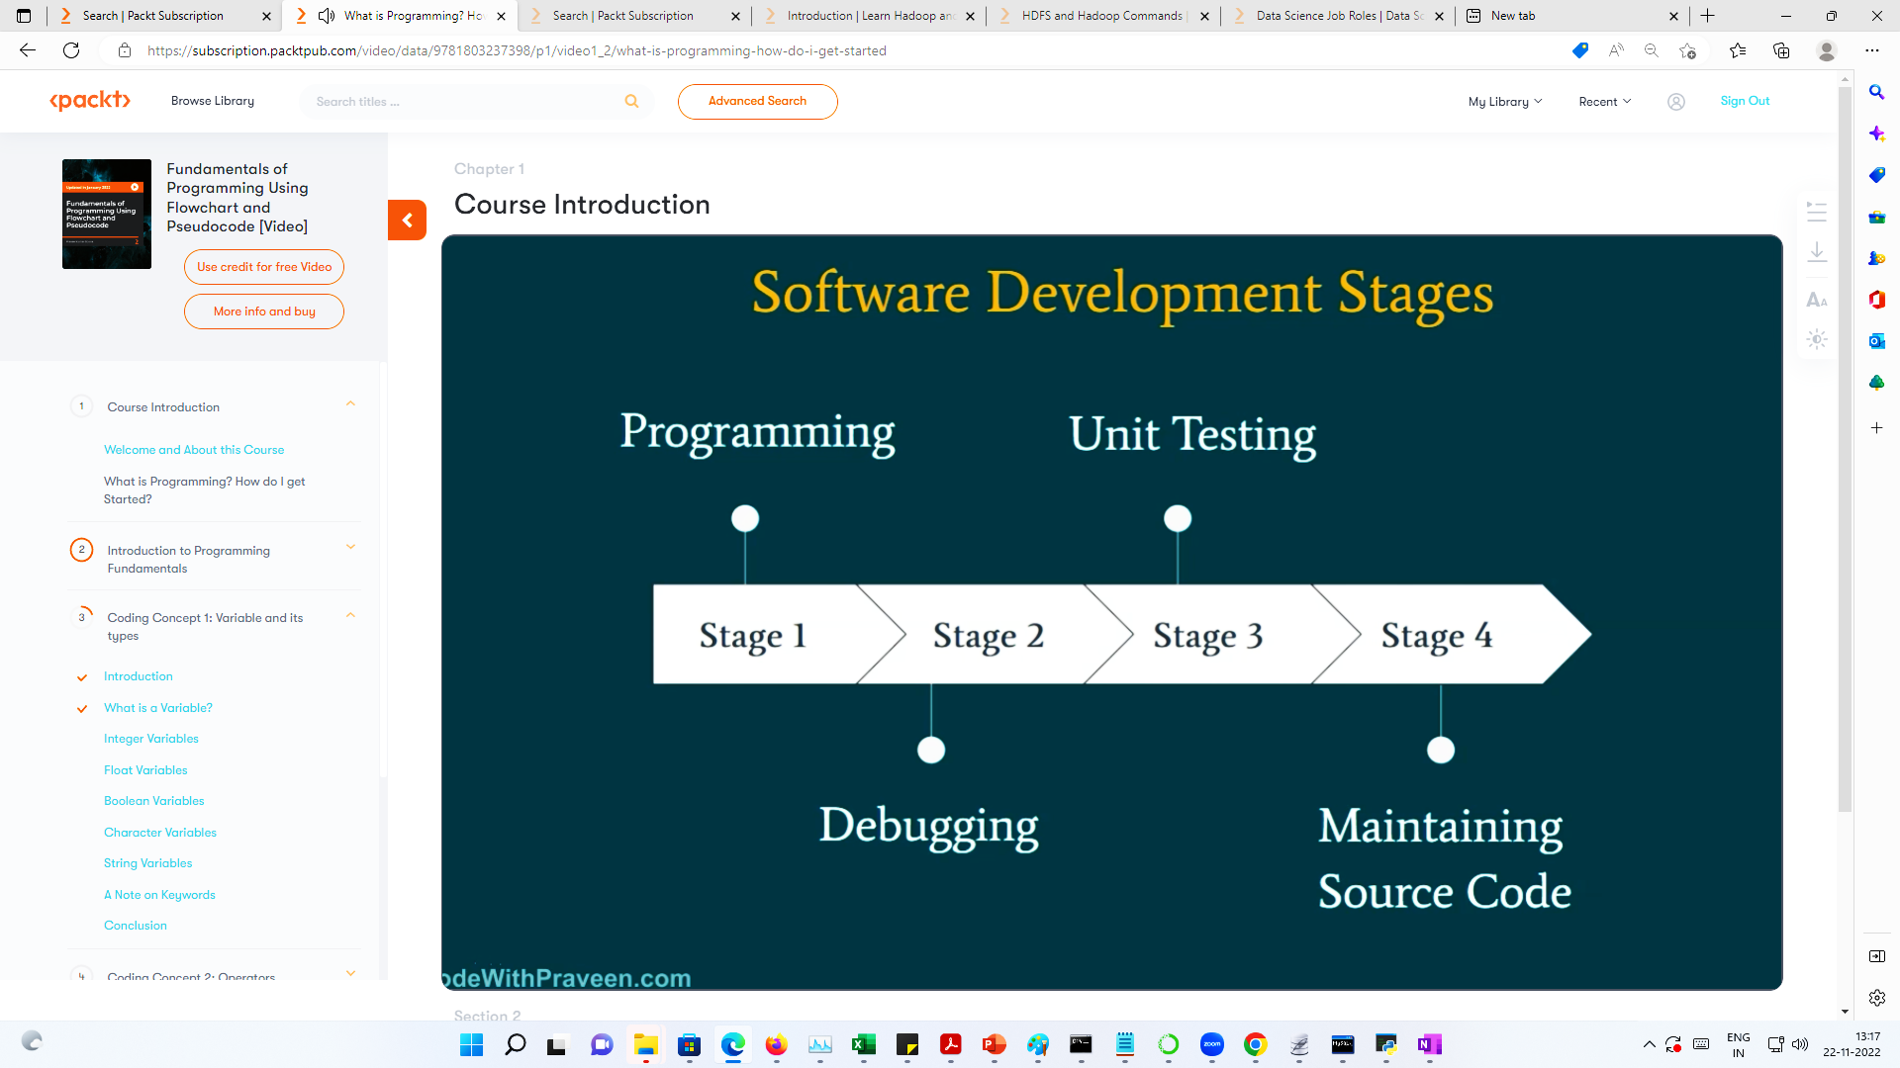
Software Development Stages

Slide 6
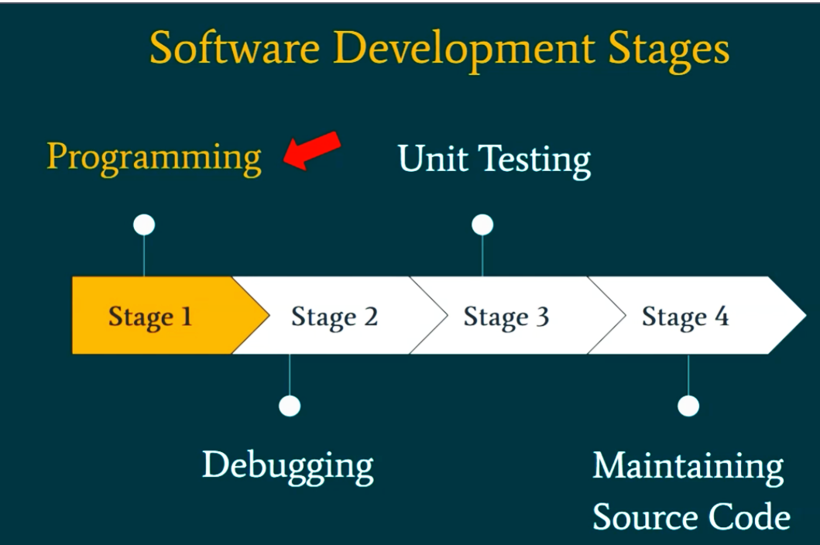
Software Development Stages – Current Lesson

Slide 7
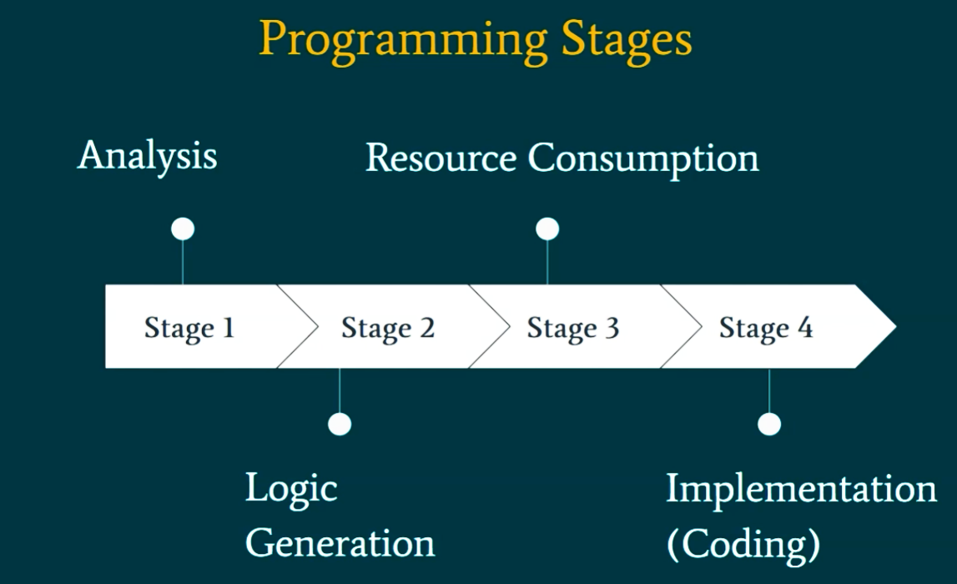
Software Development Stages – Programming Stages

Slide 8
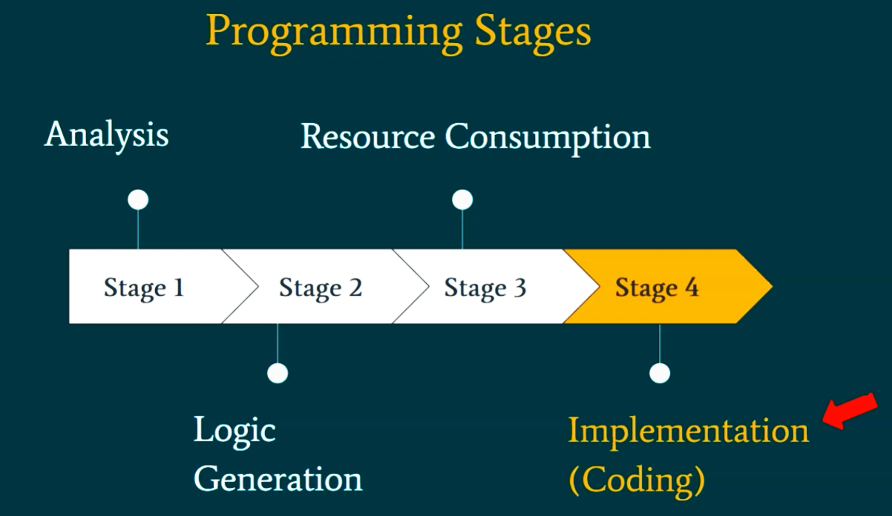
Programming Stages- Implementation(coding)

Slide 9
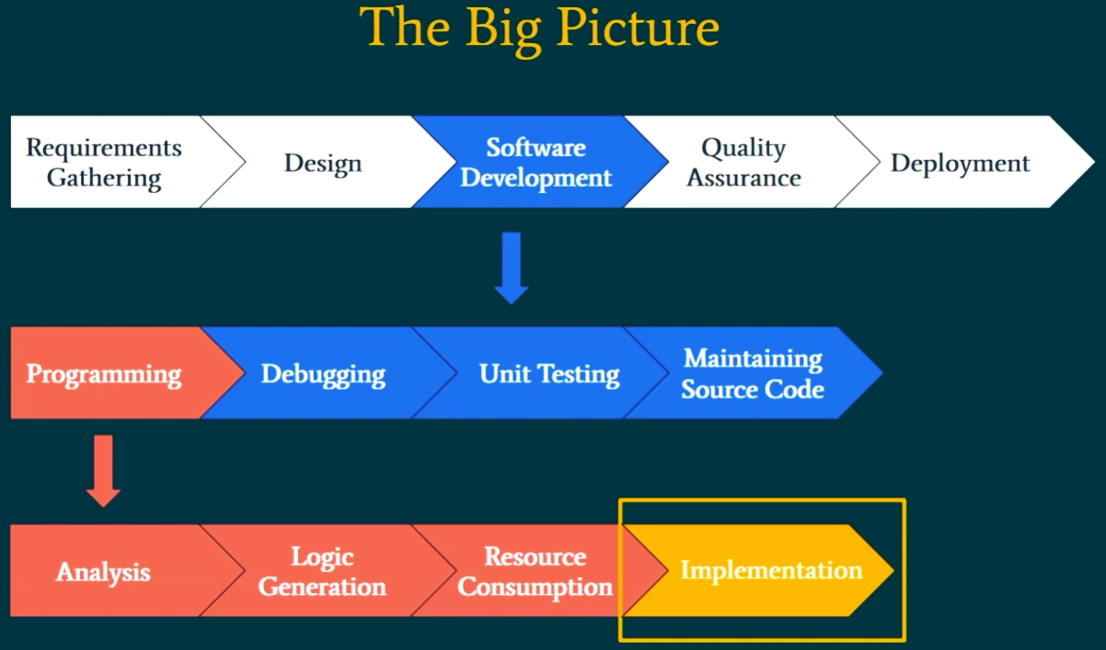
The Big Picture

Slide 10
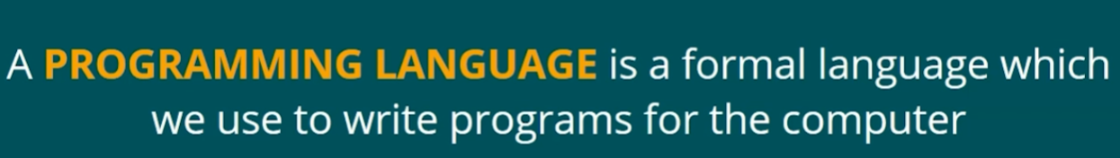
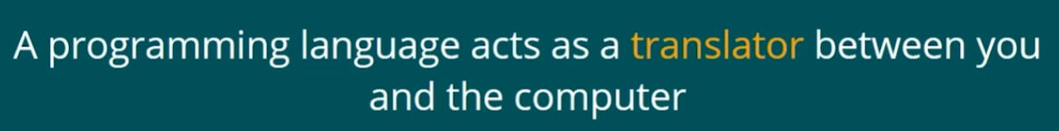
PROGRAM -Definition
A PROGRAM refers to a set of instructions we provide for the computer to give an output. Telling a computer what to do.

Slide 11
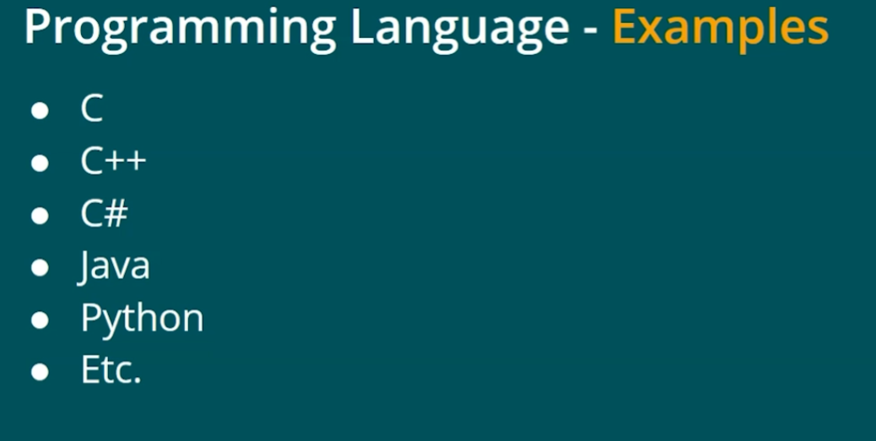

Slide 12


Slide 13
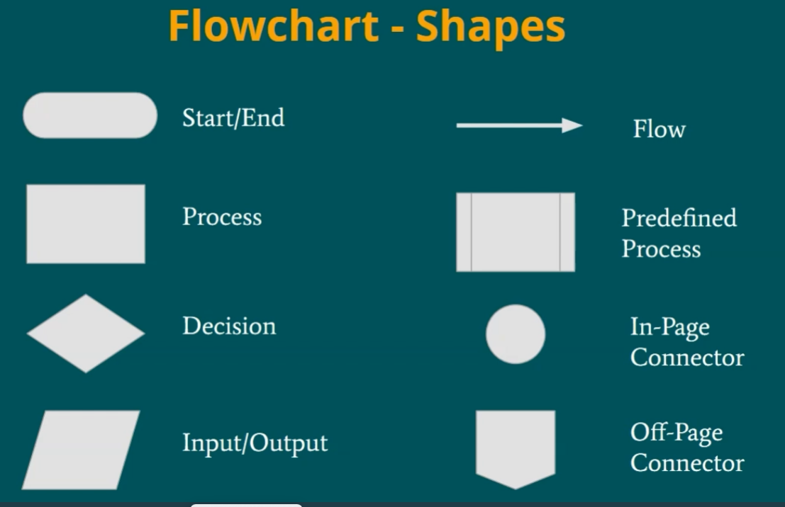

Slide 14
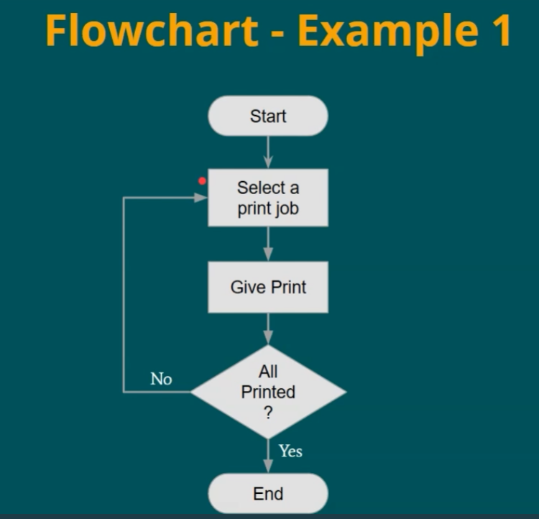

Slide 15
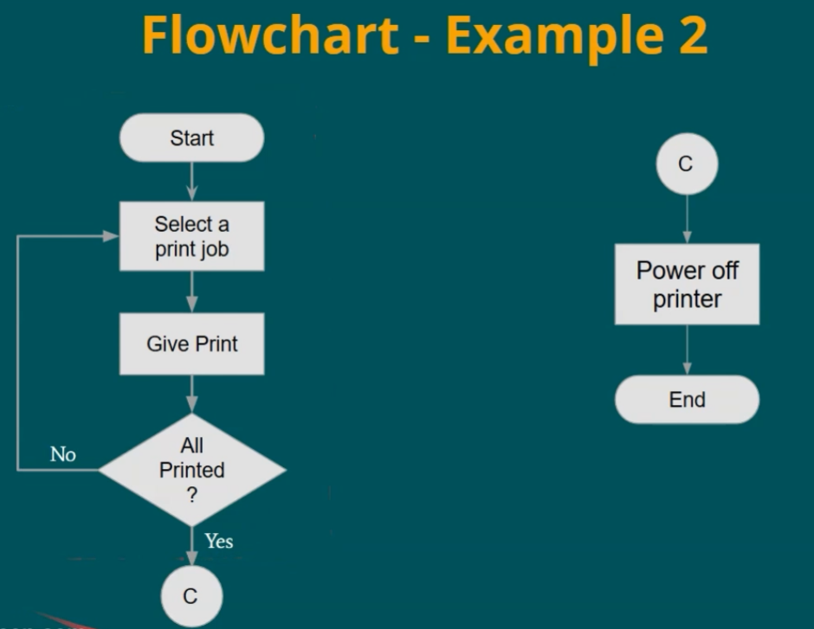

Slide 16
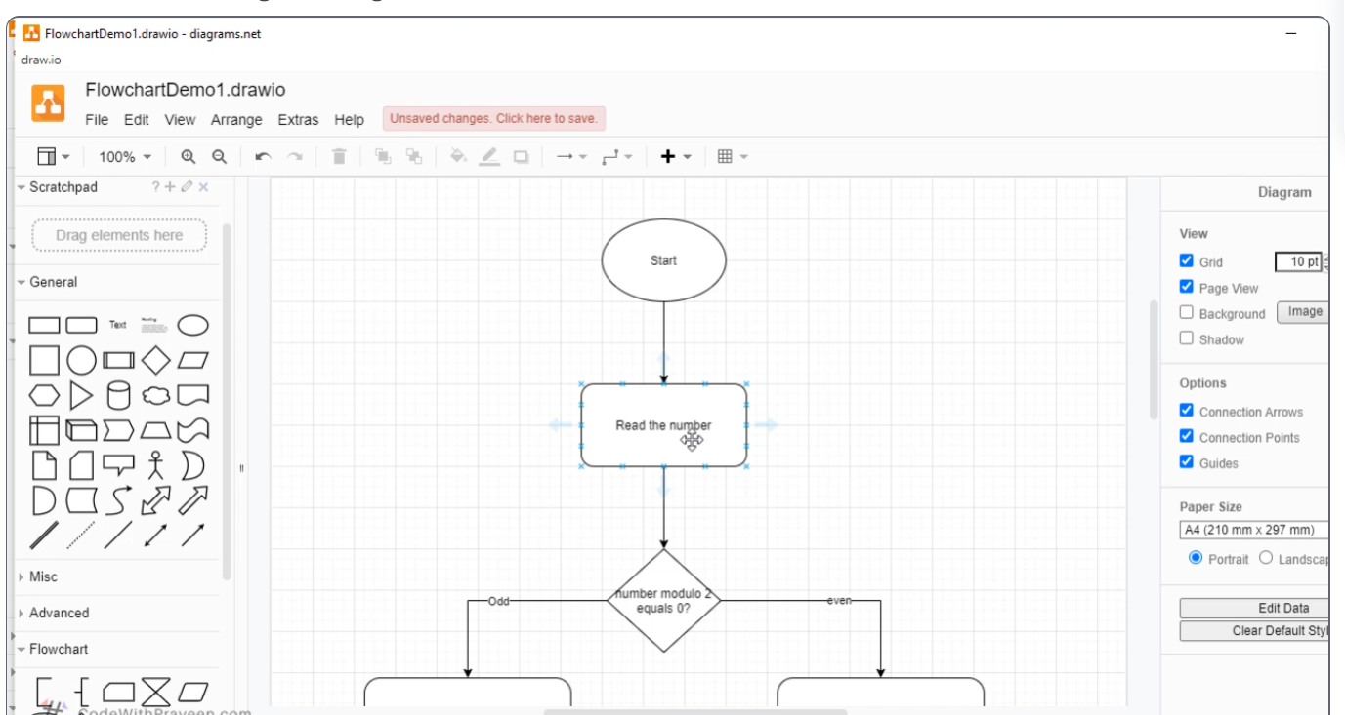

Slide 17

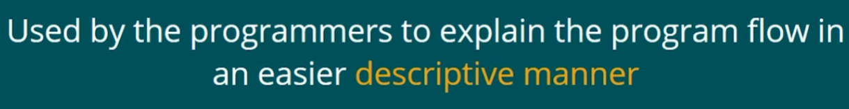

Slide 18
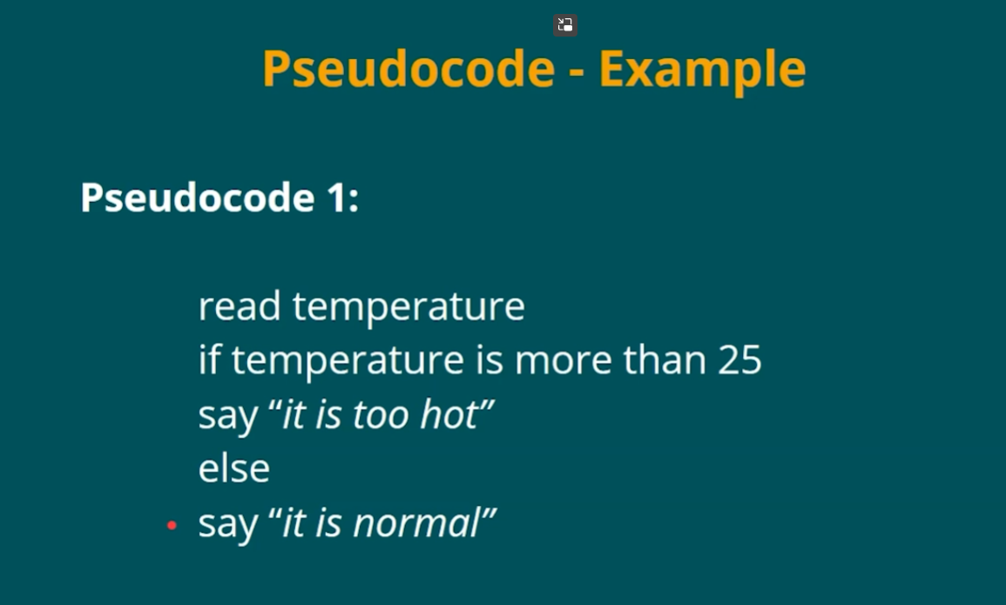

Slide 19
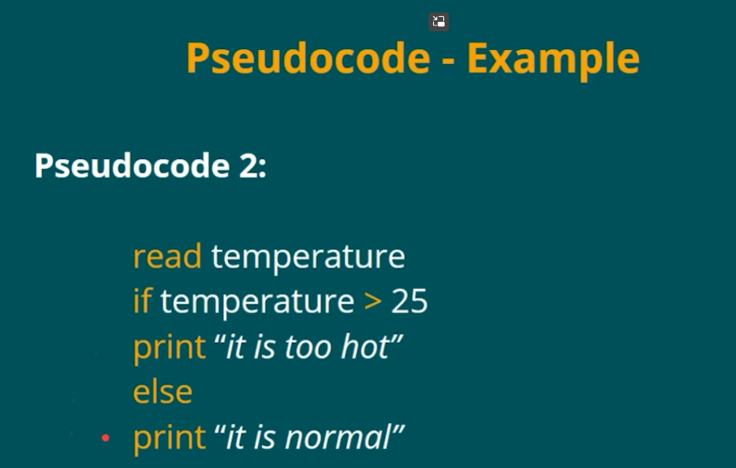

Slide 20
